Slide 1

Speech Analysis
Dr Christos Ilioudis

Slide 2
Outline
Speech Capturing and Digitisation
Time-Frequency Representation of Speech
Applications

Slide 3
Capturing and Digitisation
Sampling and quantisation of speech signals

Slide 4







Digital Speech Capturing
Analogue Acoustic
A sound source is emitting an acoustic signal towards a microphone;
The microphone converts the acoustic signal to electrical;
An analogue to digital converter (ADC) converts the electrical signal to a stream of digital samples.
Analogue Electrical
Digital Audio
Notes:
The process of digital speech capturing can be expressed in three main steps:
First a sound source is emitting an acoustic signal towards a microphone;
The microphone captures the acoustic signal and converts it to electrical;
Finally, an analogue to digital converter converts the electrical signal from the microphone to a stream of digital samples witch can then be captured and stored.

Slide 5

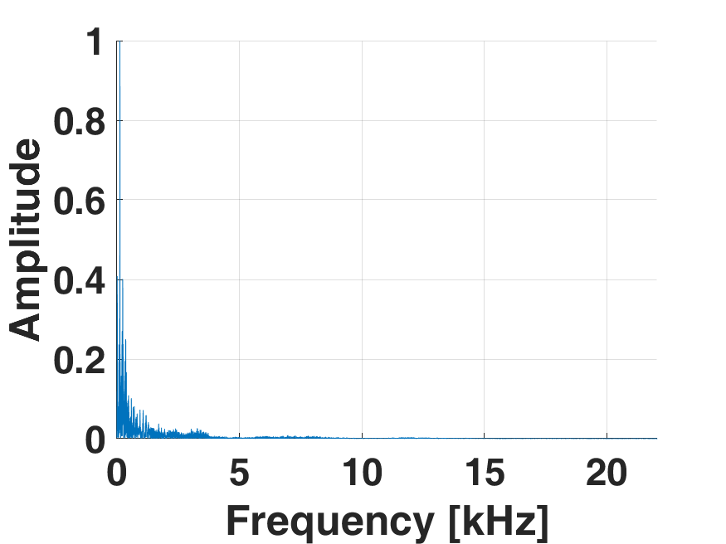
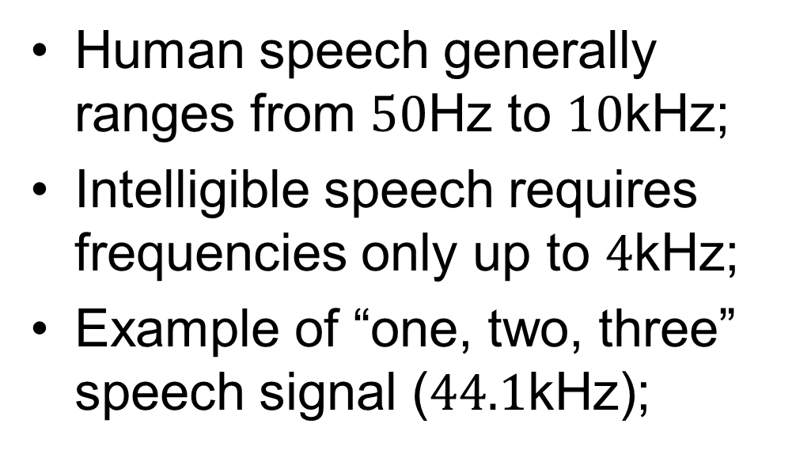
Sampling Speech Signals
Human speech generally ranges from $50$Hz to $10$kHz;
Intelligible speech requires frequencies only up to $4$kHz;
Example of “one, two, three” speech signal ($44.1$kHz);
Notes:
Speech sound generally range from 50Hz to 10kHz;
And while the full bandwidth of the signal is covered by the human hearing; intelligible speech usually requires frequencies of only up to 4kHz;
Here we have an example of a person counting from one to three sampled at 44.1kHz;

Slide 6
Sampling Speech Signals
Human speech generally ranges from $50$Hz to $10$kHz;
Intelligible speech requires frequencies only up to $4$kHz;
Example of “one, two, three” speech signal ($44.1$kHz);
Notes:
As it can be seen from the spectrum, most of the energy of the signal is concentrated at frequencies below 4KHz

Slide 7
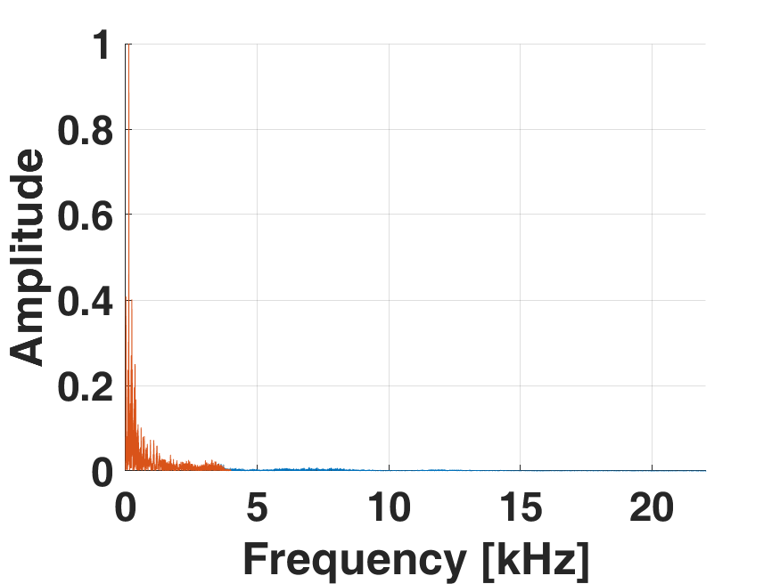
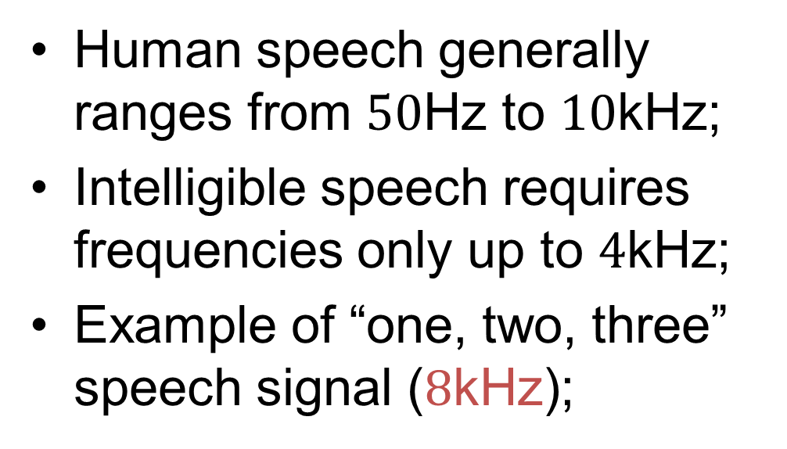
Sampling Speech Signals
Human speech generally ranges from $50$Hz to $10$kHz;
Intelligible speech requires frequencies only up to $4$kHz;
Example of “one, two, three” speech signal ($8$kHz);
Notes:
So lets see what happens if we sample the signal at 8kHz;
Remember that sampling at 8kHz allows us to capture correctly frequencies up to 4kHz.
While the down-sampled signal appears to be slightly distorted compared to the original; all the words can be easily identified.

Slide 8
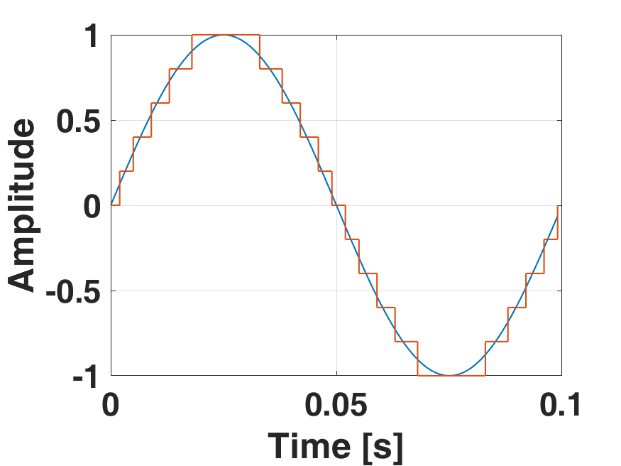
Quantisation
The process of mapping a value from continuous to discrete levels;
Both sampling and quantisation are needed for digitisation;
Notes:
Another process required for digital recording is the quantisation; which is actually the process of mapping a value from continues levels to discrete.
In the figure we can see an example of a signal with continues amplitude, see the blue line;
And the same signal after been quintised in 11 levels, represented by the red line;
It should be mentioned that both sampling and quantisation are needed to digitise a signal.

Slide 9
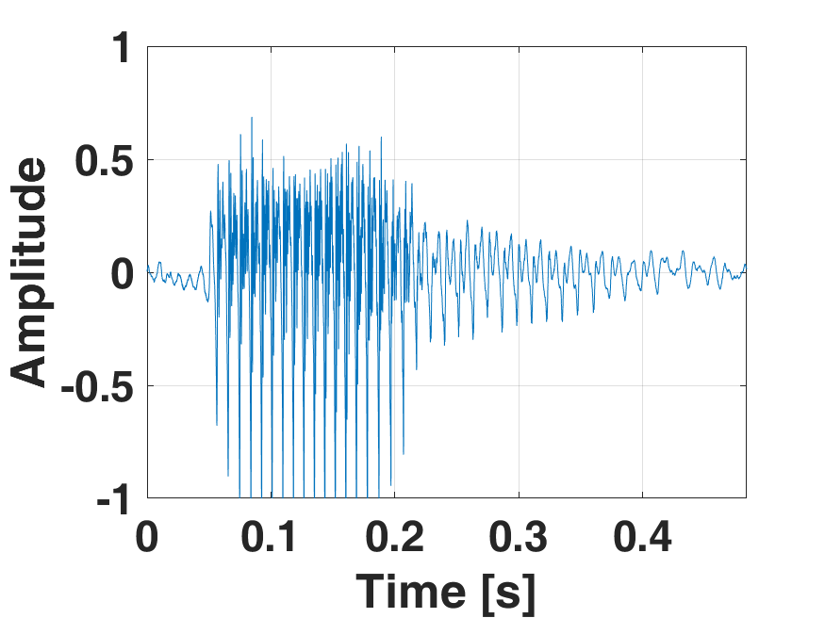
Quantisation Error
The difference between the original and the quantised value is called quantisation error;
Example of “one” speech signal.
Notes:
The difference between the original values and the quantised is called quantisation error;
Here we have a speech signal example of the word “one” quantised with a very high number of levels;
Let us assume that the signal is very close to the original and therefore the quantisation error is approximated to 0%.

Slide 10
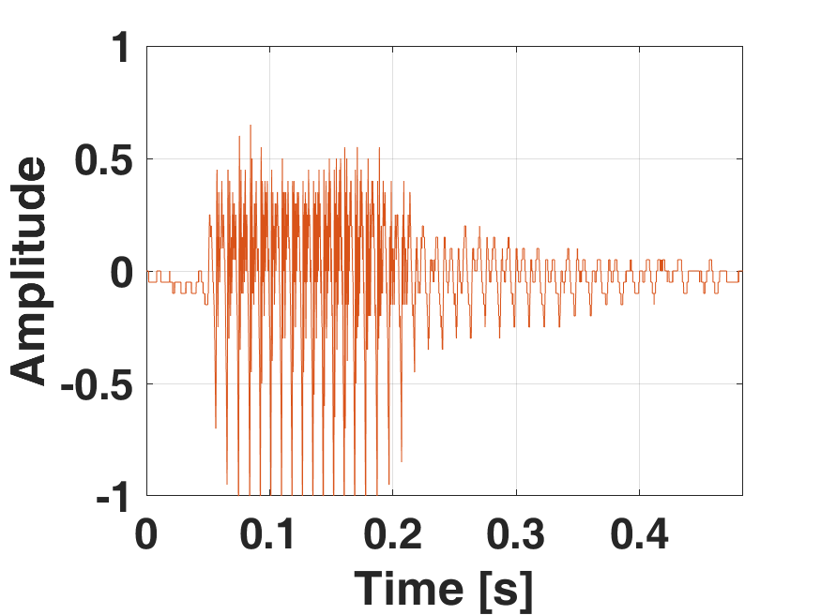
Quantisation Error
The difference between the original and the quantised value is called quantisation error;
Example of “one” speech signal (42 levels).
Notes:
Now, lets hear the same signal quantised with 42 levels;
As we can hear the quality of the signal has been slightly degraded;

Slide 11
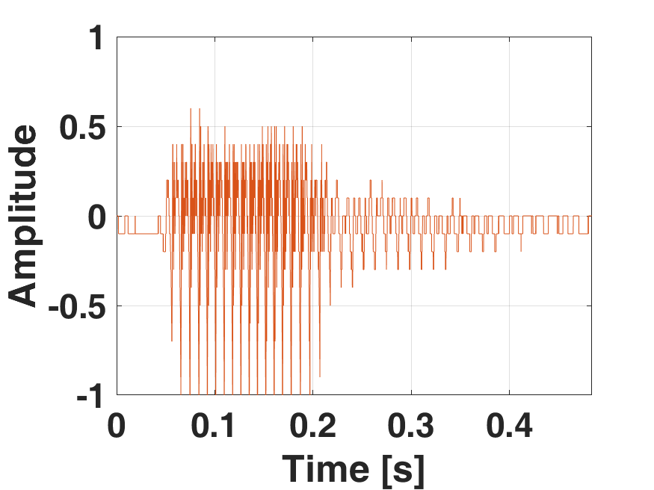
Quantisation Error
The difference between the original and the quantised value is called quantisation error;
Example of “one” speech signal (22 levels).
Notes:
Moving to even lower quantisation levels; let us hear the signal with 22 levels;
In this case the quality of the signal has been significantly degraded.

Slide 12
Data rate
“Perfect” signal digitisation would require high sampling frequency and large number of quantisation levels;
Quantisation levels define the bits per sample;
Sampling frequency defines the samples per second;
Together they define the data stream rate;
Bits/Samples × Samples/Second = Bits/Second
Compromise quality in exchange for low data rates.
Notes:
From what we learned in this lecture; perfect signal ditigisation would required high sampling frequency and large number of quantisation levels.
The number of quantisation levels will define the how many bits will be needed for every sample; with more levels requiring more bits per sample;
Moreover; the sampling frequency defines how many samples are captured per second; again with higher frequencies leading to more samples per second;
To compute therefore the data rate of the captured signal; all we have to do is multiply the bits per sample and the samples per second;
We can therefore see that the similarity of the digitised signal with its original is proportionally related to the data rate.
In many applications, the quality of the signal has to be sacrificed in exchange for lower data rates.

Slide 13
Time-Frequency Representation of Speech
How to resolve different speech characteristics using wideband and narrowband spectrogram

Slide 14
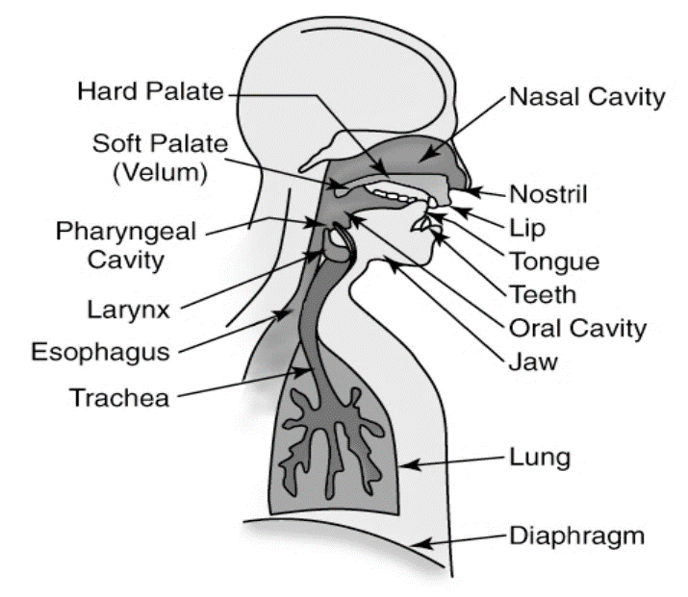
Speech Production Model
Lungs produce a combination of periodic air pulses and a random flow of air;
The periodic pulses excite the voice box and causes it to resonate in a characteristic way.
Notes:
Starting with the production model; here we can see an abstract representation of the human speech production system.

Slide 15
Speech Production Model
Lungs produce a combination of periodic air pulses and a random flow of air;
The periodic pulses excite the voice box and causes it to resonate in a characteristic way.
Notes:
At the first step, the lungs produce a combination of periodic air pulses and a random flow of air;

Slide 16
Speech Production Model
Lungs produce a combination of periodic air pulses and a random flow of air;
The periodic pulses excite the voice box and causes it to resonate in a characteristic way.
Notes:
The periodic pulses travel from the lungs to the vocal box; and excite the vocal cords causing them to resonate in a characteristic way;

Slide 17
Speech Production Model
The random flow passes through the voice box and is shaped by the mouth;
Speech is made up of sounds emanating from the entire vocal tract (voice box, mouth and nasal area).
Notes:
Moreover, the random air flow also passes through the voice box and is shaped by the mouth;

Slide 18
Speech Production Model
The random flow passes through the voice box and is shaped by the mouth;
Speech is made up of sounds emanating from the entire vocal tract (voice box, mouth and nasal area).
Notes:
Combining these processes, speech is made up by the sound emanating from the entire vocal tract; which includes the voice box, mouth and nasal area.

Slide 19
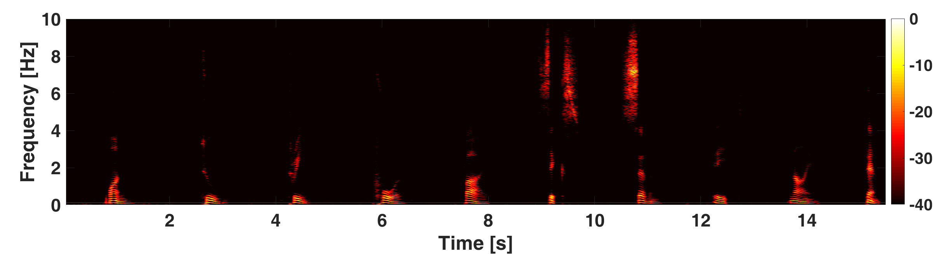
Time-Frequency representation of Speech
Complex frequency varying signal;
[kHz]
Notes:
As we know, time frequency representations are more suitable to represent signals with varying frequency.

Slide 20
Time-Frequency representation of Speech
Complex frequency varying signal;
[kHz]
“One”
“Two”
“Three”
“Four”
“Five”
“Six”
“Seven”
“Eight”
“Nine”
“Ten”
Notes:
Here we can see the spectrogram of a speech signal from a person counting from one to ten.
Please notice that the intensity is depicted in decibels, which is a logarithmic scale;
This allows us to clearly depict a wider range of changes in intensity.

Slide 21
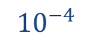
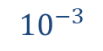
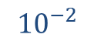
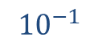

Time-Frequency representation of Speech
Complex frequency varying signal;
Linear
$$1$$
[kHz]
$${10}^{−1}$$
$${10}^{−2}$$
“One”
“Two”
“Three”
“Four”
“Five”
“Six”
“Seven”
“Eight”
“Nine”
“Ten”
$${10}^{−3}$$
$${10}^{−4}$$
Notes:
To convert dBs to linear scale, all we need to do is divide the value by 10 and place it as a power of 10.
Key values to remember are that 0dB is equal to 1 in linear scale;
-10dB is 1 divided by 10;
-20dB is 1 divided by 100;
And so on…

Slide 22
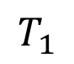
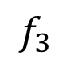
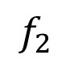
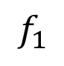
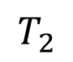
Speech Characteristics
$$T_{1}$$
$$T_{2}$$
Pitch is related to the amplitude changes due to the vocal cords closure;
Formant is a frequency shaping that results from an acoustic resonance of the human vocal tract.
$$f_{1}$$
$$f_{2}$$
$$f_{3}$$
Notes:
While there are several speech characteristics, here we are going to focus on the pitch and formants;
Pitch is related to the amplitude changes due to the vocal cords closure;
On the top figure we can see three of these amplitude changes, with two different time spacings T1 and T2.
As T2 is longer than T1 we can say that in this example the pitch period increased;
Formant refers to the frequency shaping duet to the acoustic resonance of the vocal track;
On the bottom figure we can see three segments, each of which having different frequency f1 f2 and f3.

Slide 23
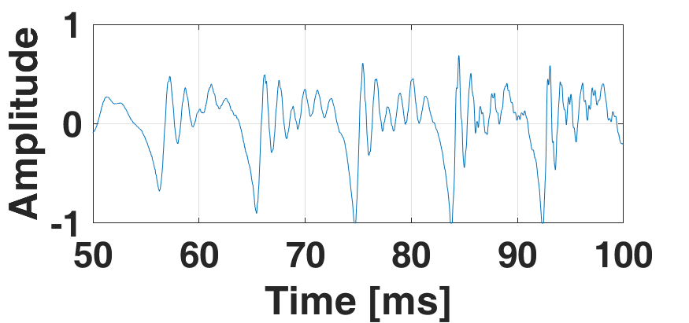
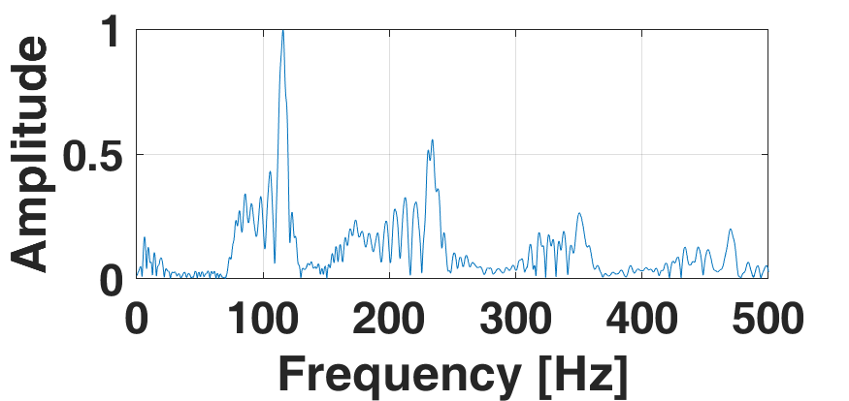
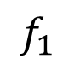
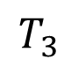
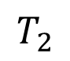
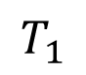
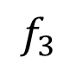
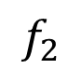
Speech Characteristics
$$T_{1}$$
$$T_{2}$$
$$T_{3}$$
Pitch period is a time observable phenomenon while formants are observed in the frequency domain;
Proper window parameters shall be used to observe them in a spectrogram.
$$f_{1}$$
$$f_{2}$$
$$f_{3}$$
Notes:
From their definition, it is easy to determine that the pitch is a time observable phenomenon; While the formants are observed in the frequency domain.
For a better understanding; here we can see parts of the time and frequency domain of the word “one” that we saw earlier;
As it can be seen from the top figure, the changes in amplitude related to the pitch are easily defined;
While from the bottom figure; the different formant frequencies of the same signal can be seen.
Since the two phenomena occur simultaneously; in order to observe both of them in a spectrogram, a proper window length shall be used.

Slide 24
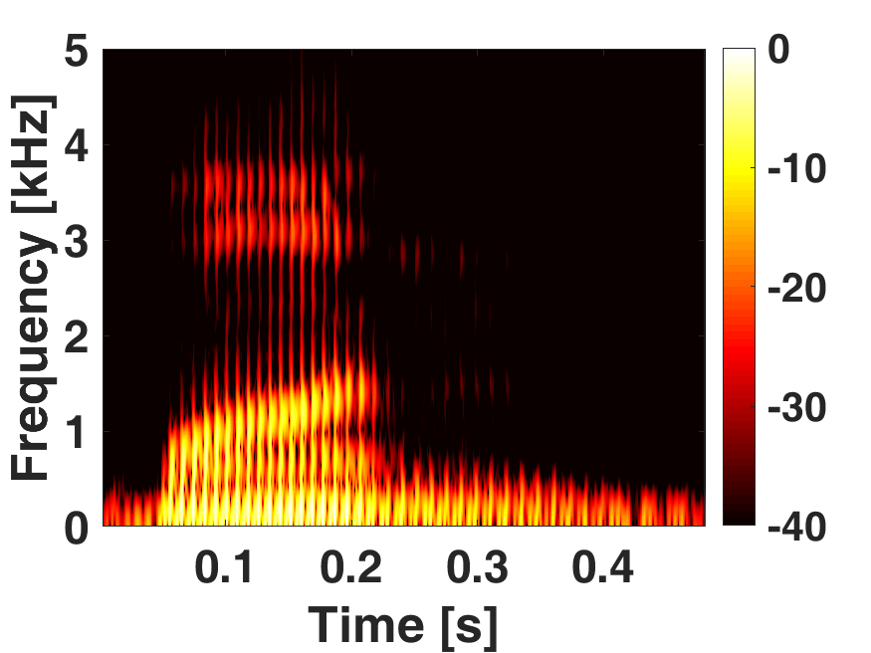
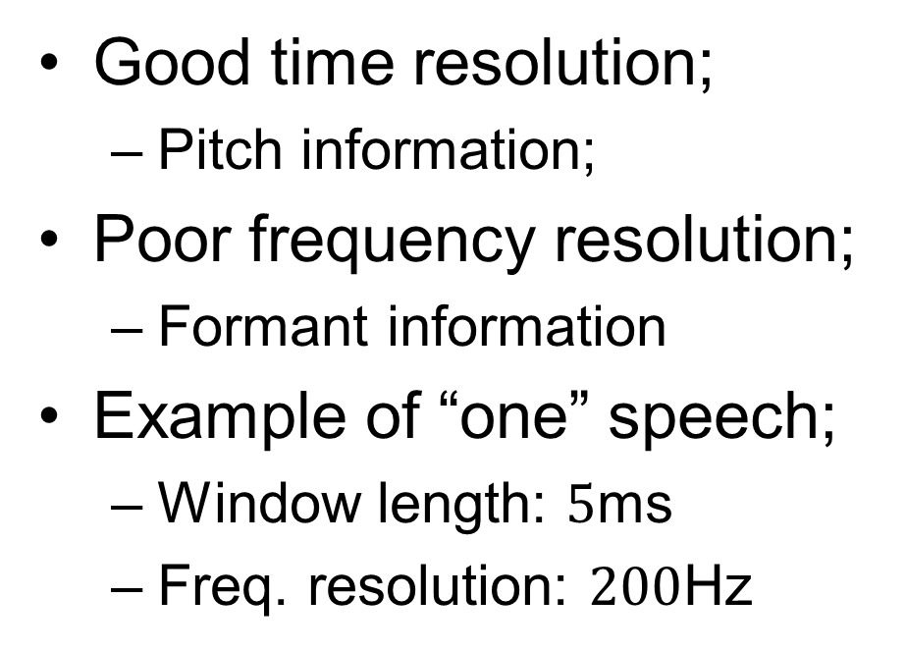
Wideband Spectrogram
Good time resolution;
Pitch information;
Poor frequency resolution;
Formant information
Example of “one” speech;
Window length: $5$ms
Freq. resolution: $200$Hz
Notes:
As we know, wideband spectrograms offer better time resolution and poor frequency resolution;
In this example, the spectrogram of the word “one” is illustrated when a window of 5ms is used, which also results to 200Hz frequency resolution.
As we can see, individual vertical lines are present related to the pitch of the speech;
Moreover, since the frequency resolution is low, the formant information cannot be easily extracted.

Slide 25
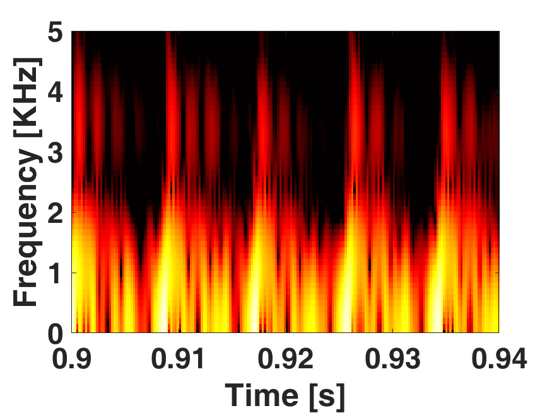
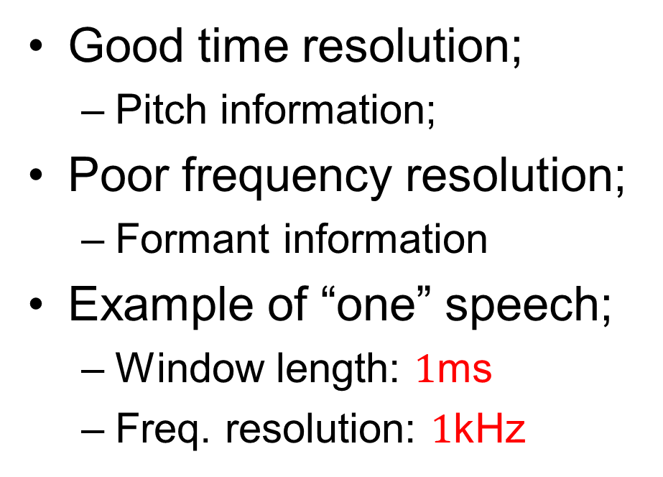


Wideband Spectrogram
Good time resolution;
Pitch information;
Poor frequency resolution;
Formant information
Example of “one” speech;
Window length: $1$ms
Freq. resolution: $1$kHz
$\sim 9$ms
$\sim 9$ms
Notes:
In this case, information about the pitch can be easily extracted by measuring the distance between the different vertical lines.
Here we can measure a distance of approximately 90ms.

Slide 26
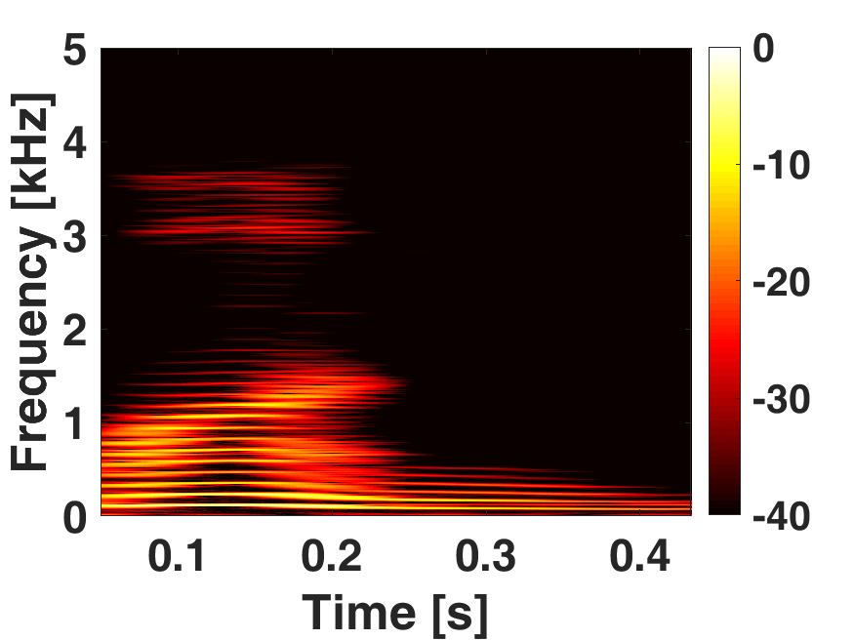
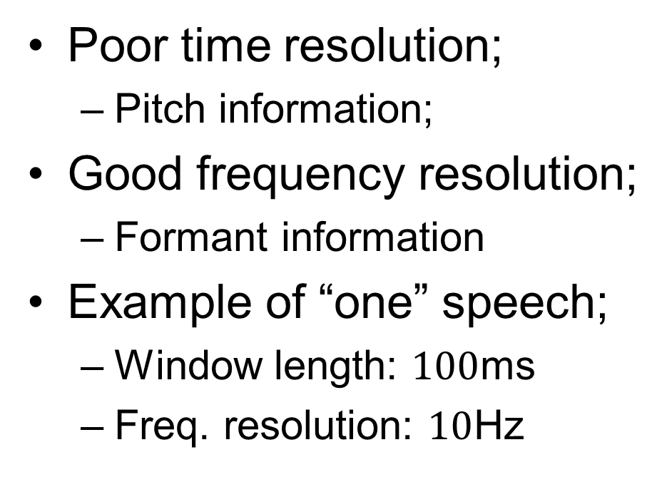
Narrowband Spectrogram
Poor time resolution;
Pitch information;
Good frequency resolution;
Formant information
Example of “one” speech;
Window length: $100$ms
Freq. resolution: $10$Hz
Notes:
Moving to the narrowband spectrogram; here we can see the spectrogram of the same speech signal when a window of 100ms is used.
This results to a frequency resolution of 10Hz which is significantly smaller than what we saw in the previous example.
As it can be seen, now horizontal lines appear in different frequencies indicating the formants of the signal;
Furthermore, the vertical, pitch related lines have disappeared.

Slide 27
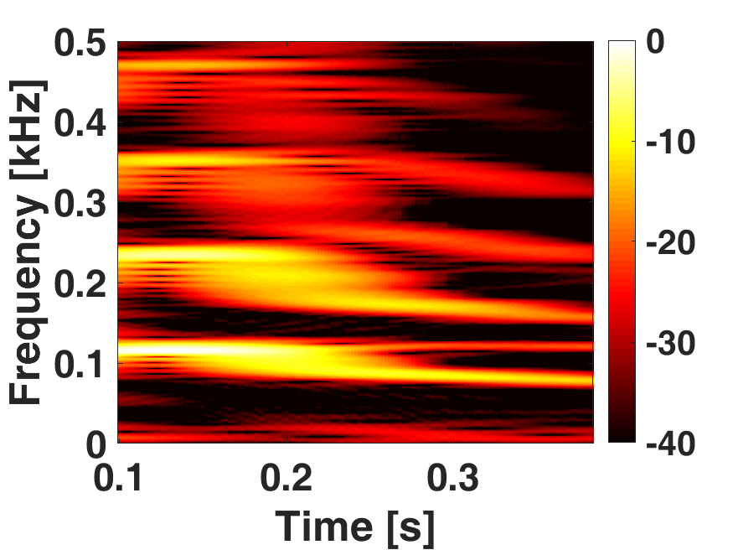
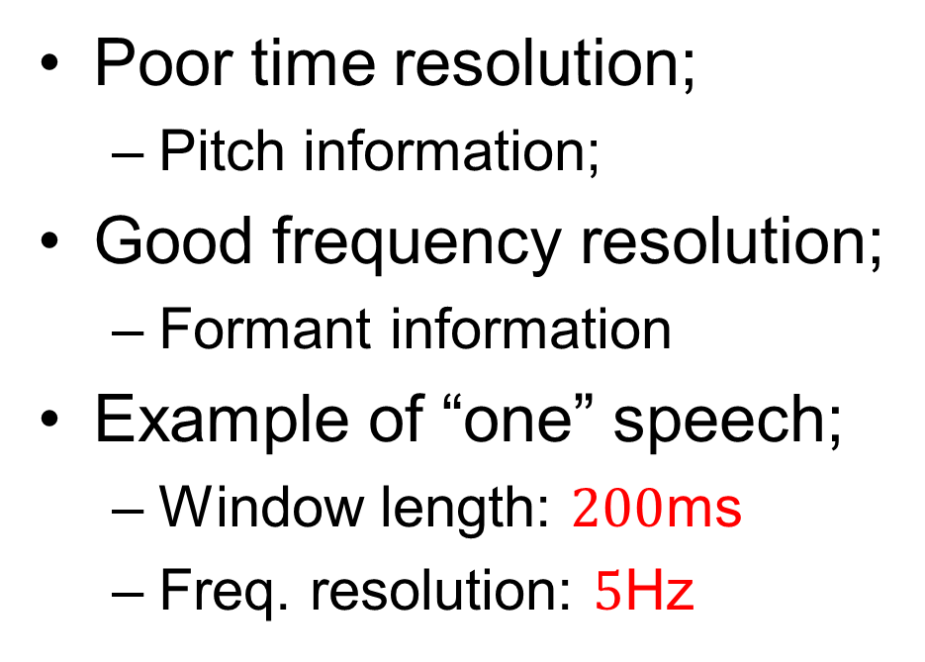
Narrowband Spectrogram
Poor time resolution;
Pitch information;
Good frequency resolution;
Formant information
Example of “one” speech;
Window length: $200$ms
Freq. resolution: $5$Hz
Notes:
For better illustration, here we can see the spectrogram from 0 to 500Hz when an even longer window is used; giving a frequency resolution of 5Hz.

Slide 28



Narrowband Spectrogram
Poor time resolution;
Pitch information;
Good frequency resolution;
Formant information
Example of “one” speech;
Window length: $200$ms
Freq. resolution: $5$Hz
$$351Hz$$
$$233Hz$$
$$115Hz$$
Notes:
From here we can easily extract that the first three formants are at 115, 233 and 351Hz.

Slide 29
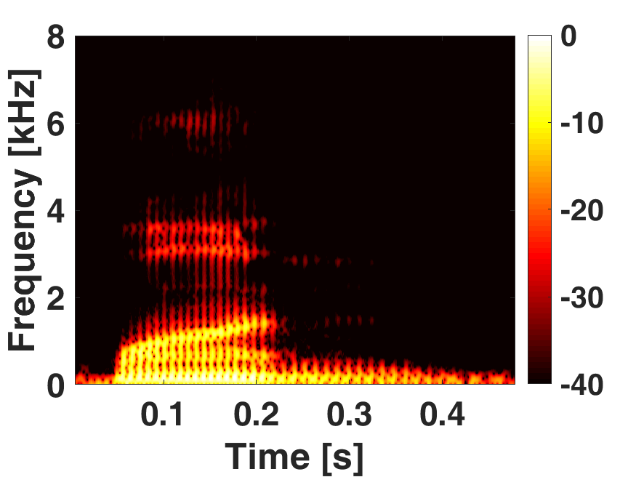
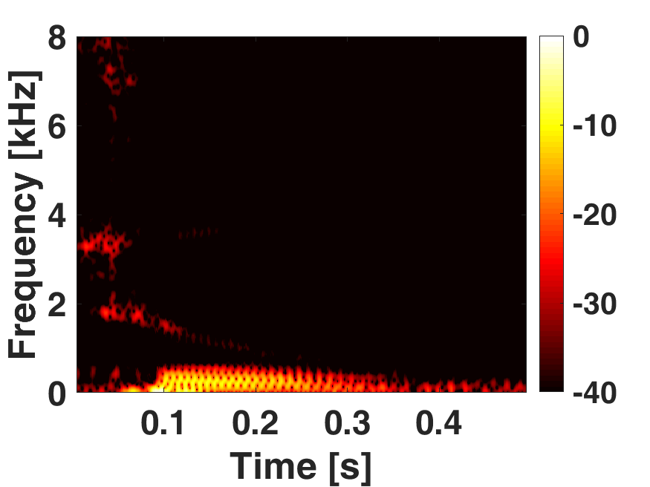
Speech analysis
Comparisons between “one” and “two” speech.
“One”
“Two”
Notes:
Moving to another example here we can see the spectrograms of the word “one” and “two” pronounced from the same person.

Slide 30
Speech analysis
Comparisons between “one” and “two” speech.
“One”
“Two”
Notes:
Comparing the two figure we can see that the two words exhibit different time frequency profiles.
Specifically, one stays longer in mid frequencies around 6,4 and 3kHz, while two stays for shorter time in high and mid frequencies 8 and 4kHz.
A speech analysis system can therefore use these information to identify different words in a recording.

Slide 31
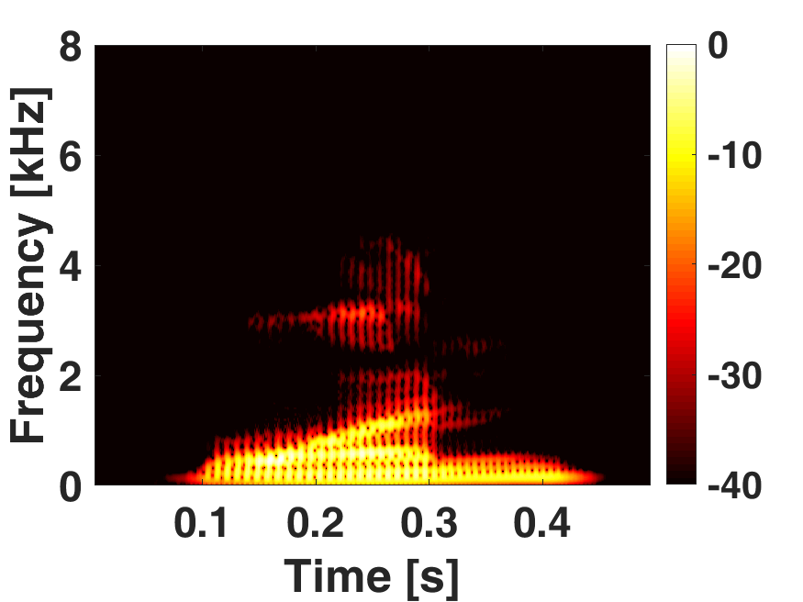
Speech analysis
“One” from two different people.
Person A
Person B
Notes:
In this example we can also see the spectrograms of the word “one” from two different males;

Slide 32
Speech analysis
“One” from two different people.
Person A
Person B
Notes:
Comparing them, we can see that while in lower frequencies the profiles look the same; In higher frequencies they look very different;
Specifically, the highest formant of the Male A is around 6kHz while for Male B is close to 5kHz.
Such information can there be used to discriminate which person is speaking.

Slide 33

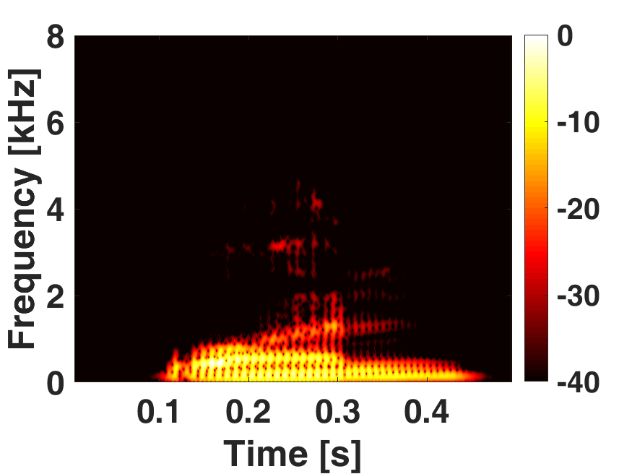
Speech analysis
“One” from the same person.
Recording A
Recording B
Notes:
Following here we can see the spectrograms of the word “one” now from the same person in two different recording.

Slide 34
Speech analysis
“One” from the same person.
Recording A
Recording B
Notes:
Comparing the two figures, we can see many similarities; with most of the time frequency components appear in same position.

Slide 35
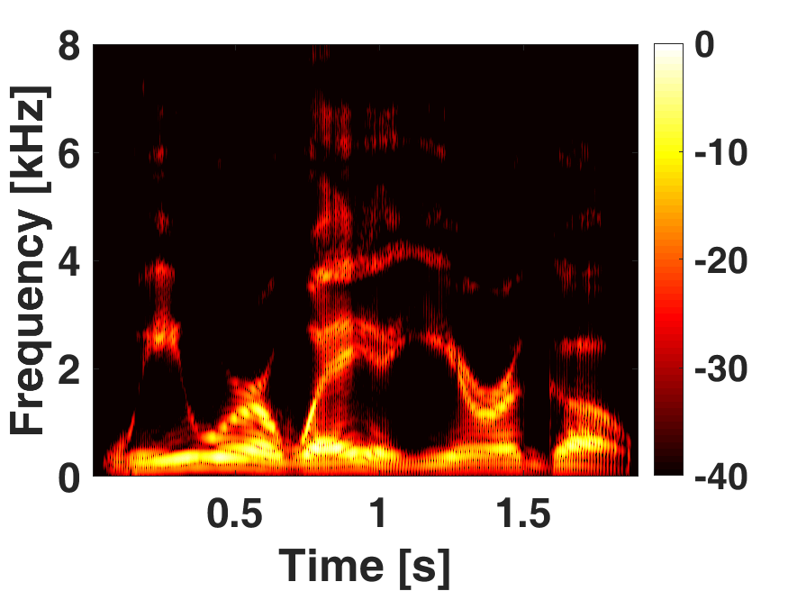
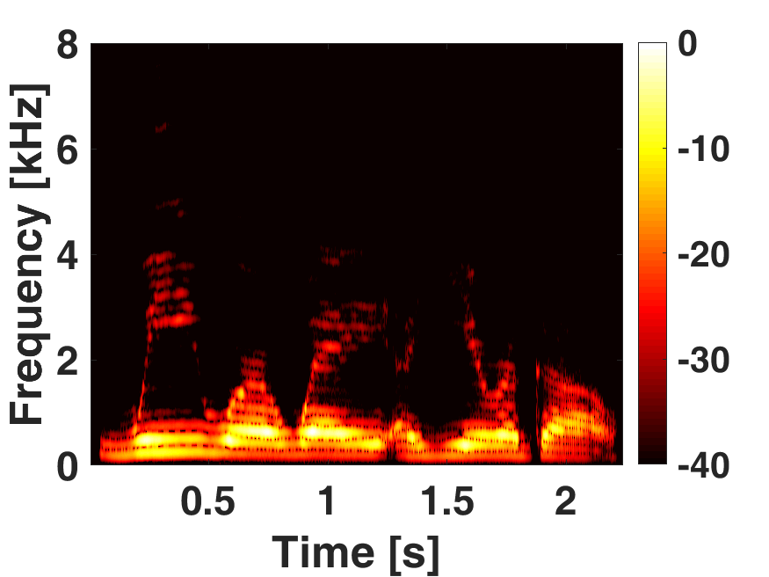
Speech analysis
“We were away a year ago” from Ian and Suzanne voice.
Ian
Suzanne
Notes:
In the last example we examine the spectrograms of a male and a female recordings pronouncing the phrase “We were away a year ago”.

Slide 36
Speech analysis
“We were away a year ago” from Ian and Suzanne voice.
Ian
Suzanne
Notes:
Comparing the two figures, we can see that they exhibit similarities;
This is normal as the signals comprise the same words.

Slide 37
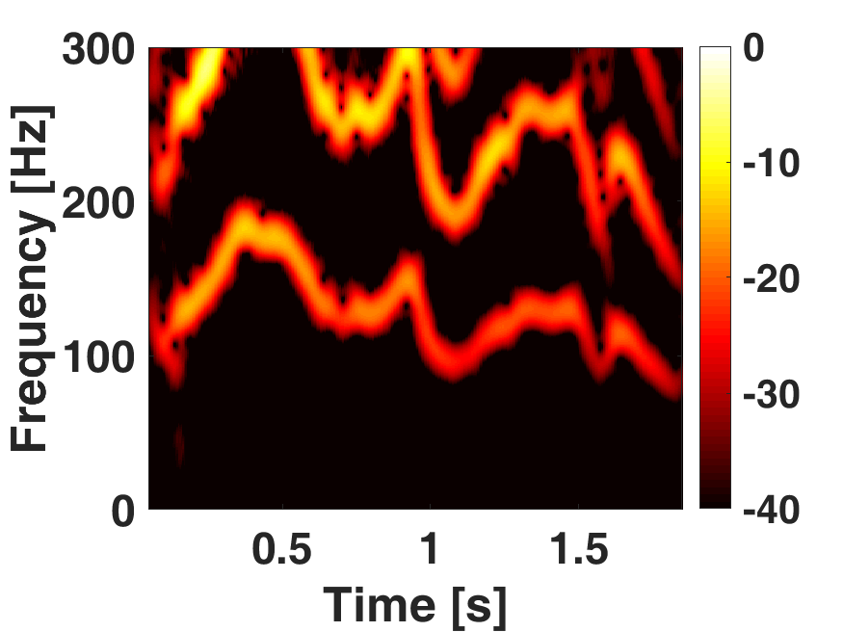
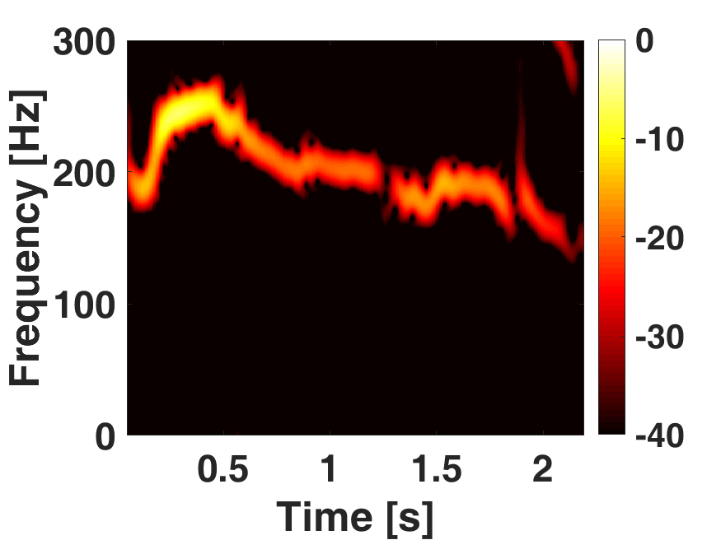
Speech analysis
“We were away a year ago” from Ian and Suzanne voice.
Ian
Suzanne
Notes:
Here we can see the narrowband version of the two spectrograms for frequencies up to 300Hz.
As it can be seen most of the time information has been lost as the pauses between the words are not distinct.

Slide 38
Speech analysis
“We were away a year ago” from Ian and Suzanne voice.
Ian
Suzanne
Notes:
Nevertheless, looking at the formant with the lowest frequency; we can see that for the male it fluctuates between 100 and 200Hz;
While for the female is between 200 and 280Hz.
This is expected as generally males exhibit lower fundamental formant than females.

Slide 39
Applications
Speech recognition

Slide 40
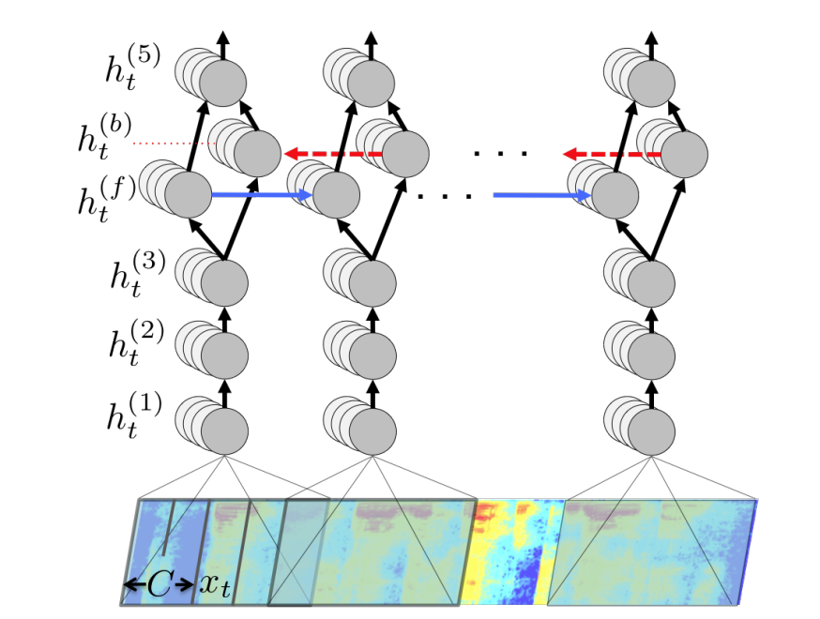
Speech recognition using Deep Leering
Spectrograms can extract unique characteristics form speech signals;
Converts an audio signal to an image translating speech recognition to an image classification problem

Slide 41
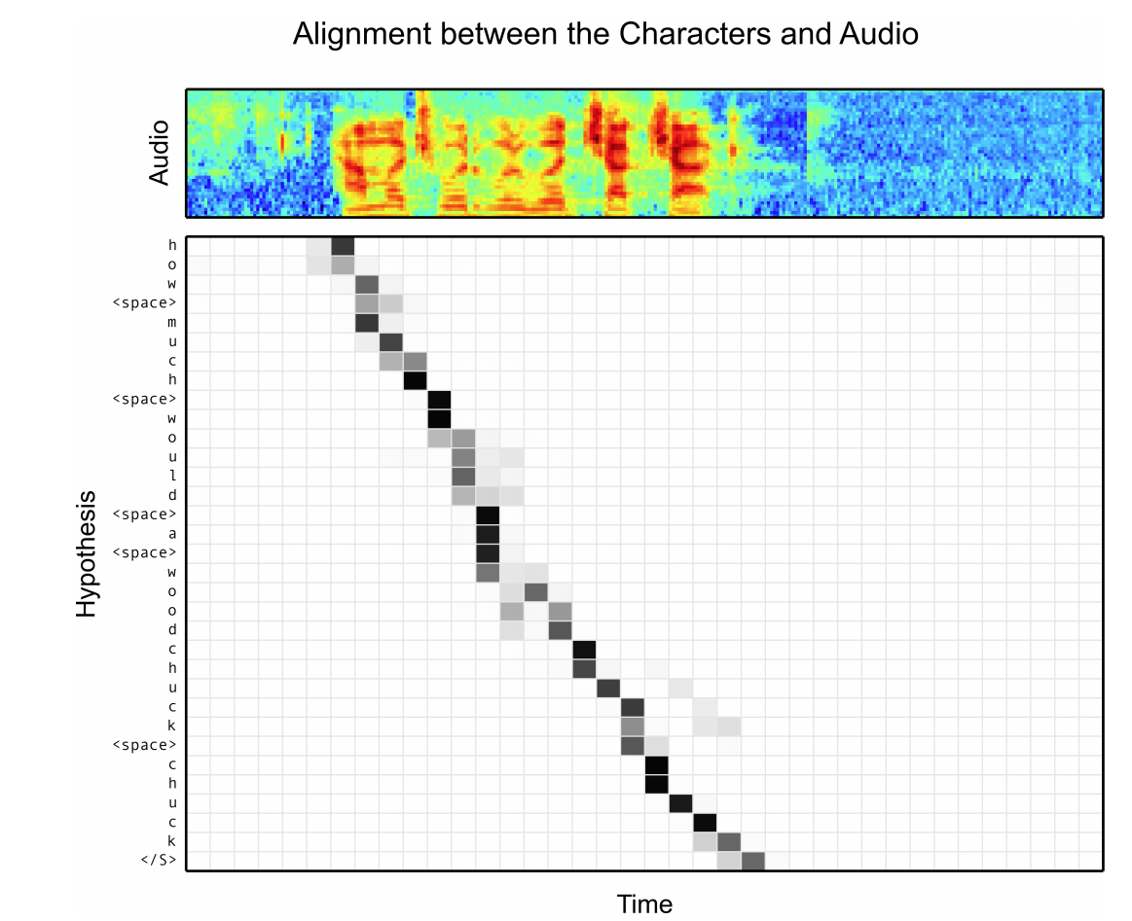
Listen, Attend and Spell (Google)

Slide 42
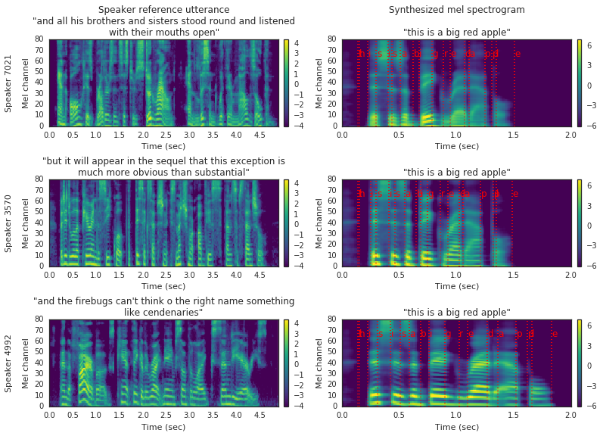
Text-To-Speech Synthesis
Jia, Ye, et al. "Transfer learning from speaker verification to multispeaker text-to-speech synthesis." arXiv preprint arXiv:1806.04558 (2018).

Slide 43
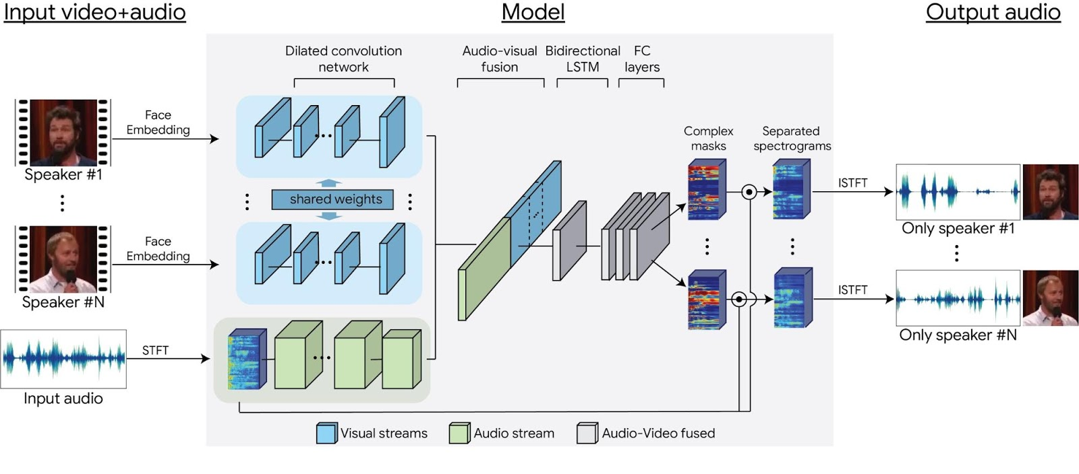
Audio-Visual Speech Separation
Ephrat, Ariel, et al. "Looking to listen at the cocktail party: A speaker-independent audio-visual model for speech separation." arXiv preprint arXiv:1804.03619 (2018).

Slide 44
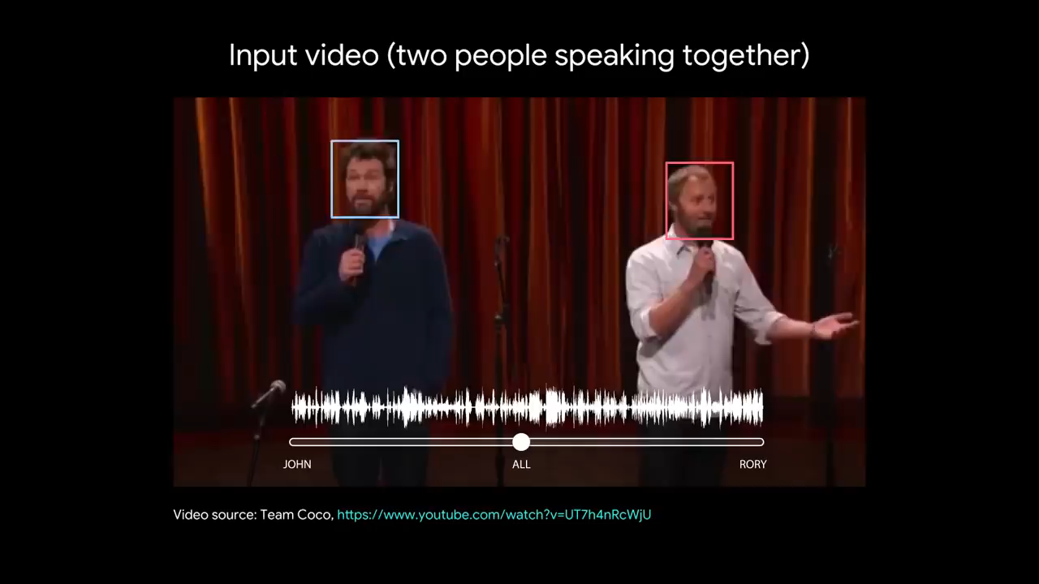

Slide 45


